Slide 1
Deep Compression: Compressing Neural Networks With Pruning, Trained Quantization, and Huffman Coding (ICLR 2016)
598 SM:Approximate And Probabilistic Computing Across the System Stack
Presented by: Daniel Campos
10/20/2020

Slide 2
Agenda
Framing
Overview
Methods Employed(Re Ordered for simplicity)
Huffman Coding
Quantization
Pruning
Results
2nd paper: Quantized Networks

Slide 3
Framing
Paper is from 2016. Set expectations around that.
Zika is the outbreak of concern
RESNET is State of art(ish) in CV.
No one has any attention based systems.
Deep Neural Networks(DNN) have proven huge in Computer Vision, NLP, ETC and are getting deployed into production systems.
Energy consumption is dominated by memory access. Access requires 3 orders of magnitude more energy than an add operation.
Model on device leads to much lower latency and less issues scaling GPU to Datacenters.
Models Keep getting bigger and bigger
ALEXNET is > 200 mb.
VGG-16 is > 500 mb
Means these models cannot be deployed easily in apps as the bloat would effect people downloading them.
Models need to be made smaller!(Obvi)
Goal make models smaller
Focus is on model size not execution size!
Small enough to fit in SRAM an thus be energy efficient.
This paper introduces a three stage approach
Pruning(Reduces weights 90%)
Quantization(with pruning weights reduced by ~96%)
Huffman Coding(with pruning and quantization weights reduced by 98%)
Without large accuracy loss

Slide 4
Overview
Deep Compression a three-stage pipeline: pruning, trained quantization and Huffman coding.
First prunes the network by learning only the important connections
Next quantize the weights to enforce weight sharing
Fine tune remaining connections
Finally apply Huffman coding

Slide 5
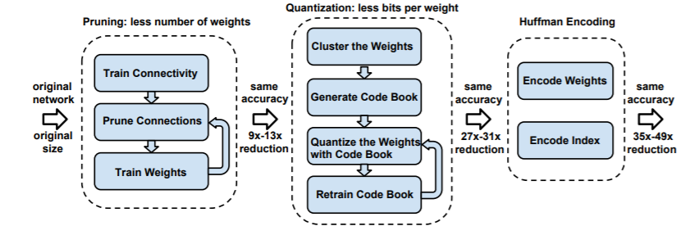

Slide 6
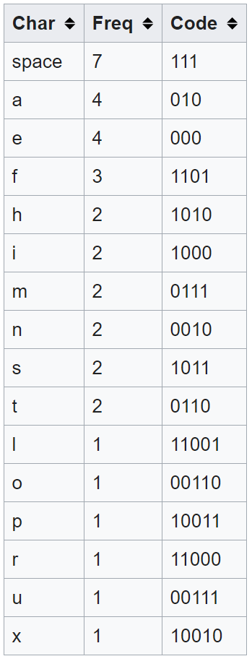
Huffman Coding
More common symbols are generally represented using fewer bits than less common symbols.
More common weights represented by a code using fewer bits

Slide 7
Quantization
Choose a level of quantization(total amount of possible weights). Create centroids using methods bellow. Weights of network are replaced with their closest weight.
When model is trained with quantized weights during back-prop the gradient is calculated for all connections that share each weight.
One level of indirection during feed forward phase and back-propagation phase looking up the weight table. Minor cost to lookup table.

Slide 8
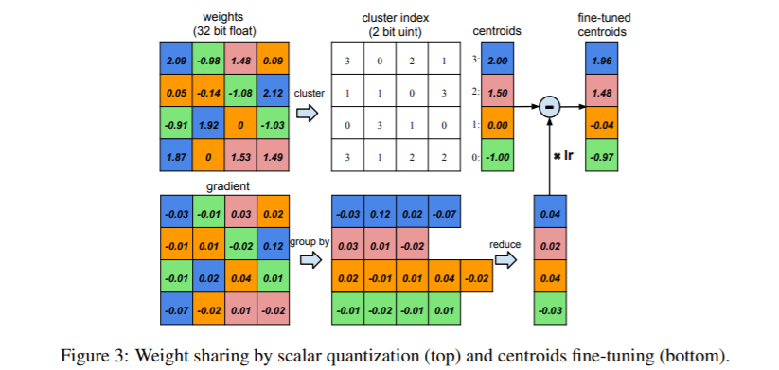
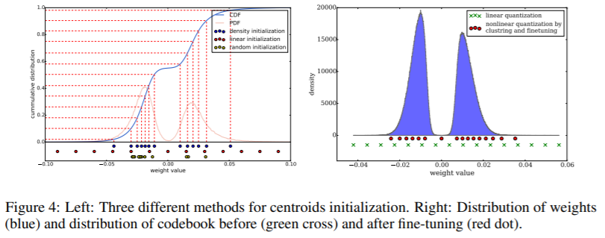
Quantization

Slide 9
Open questions
What happens if quantization were to happen over time? Could it be implemented like pruning?
What is the effect of having different Quantization at each layer?
If model is further quantized what is the effect on accuracy?

Slide 10
Pruning
Pruning is old going all the way back to 1989 with Lecun.
Approach is regular training and then after training has completed prune the small-weight connections
All connections with weights below a threshold are removed from the network.
Threshold is not discussed
No discussion if pruning is one stage or multi-stage
After punning network is retrained
Not clear if they wait until quantization to do this or retrain at pruning and quantization
Pruning reduced the number of parameters by 9× and 13× for AlexNet and VGG-16 model.
Pruned network is stored as compressed sparse row (CSR) or compressed sparse column (CSC) format, which requires 2a + n + 1 numbers, where a is the number of non-zero elements and n is the number of rows or columns. To compress further, we store the index difference

Slide 11
Results
The total size of AlexNet decreased from 240MB to 6.9MB, which is small enough to be put into on-chip SRAM, eliminating the need to store the model in energy-consuming DRAM memory. Reduced the size of VGG-16 by 49× from 552MB to 11.3MB
Pruning, reduces the number of connections by 9× to 13×;
Quantization then reduces the number of bits that represent each connection from 32 to 5.
Benchmarked on CPU, GPU and mobile GPU, compressed network has 3× to 4× layerwise speedup and 3× to 7× better energy efficiency.

Slide 12
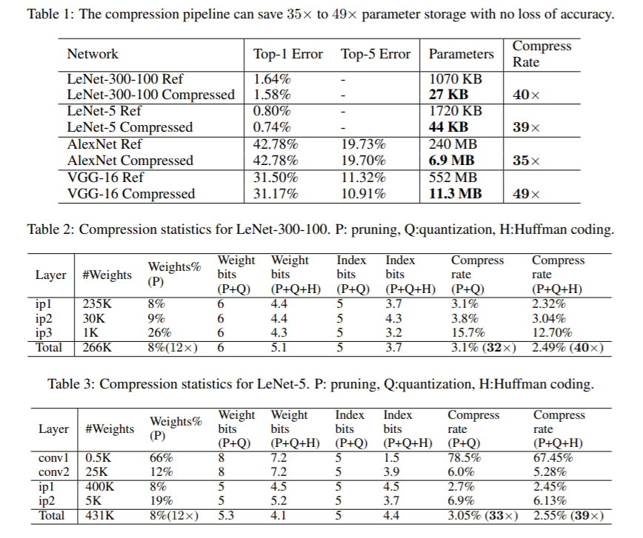
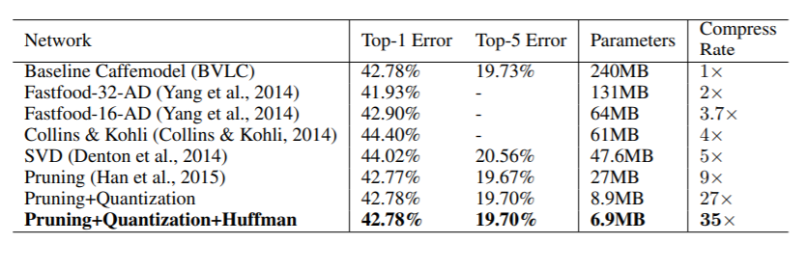
Results(cont.)

Slide 13
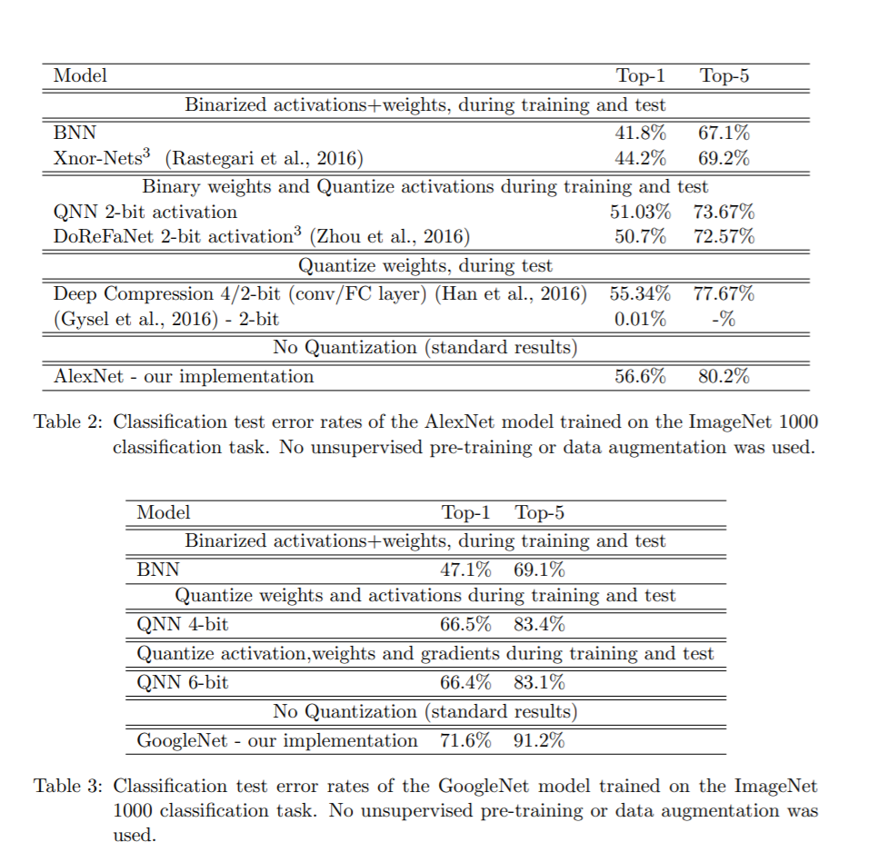
Paper 2:Quantized NN
Quantized Neural Networks (QNNs) — neural networks with extremely low precision (e.g., 1-bit) weights and activations, at run-time.
Quantize the parameter gradients to 6-bits as well which enables gradients computation using only bit-wise operation
The resulting QNNs achieve prediction accuracy comparable to their 32-bit counterparts on the MNIST, CIFAR-10, SVHN. For example, our quantized version of AlexNet with 1-bit weights and 2-bit activations achieves 51% top-1 accuracy.
Quantized recurrent neural networks were tested over the Penn Treebank dataset, and achieved comparable accuracy as their 32-bit counterparts using only 4-bits.
``

Slide 14
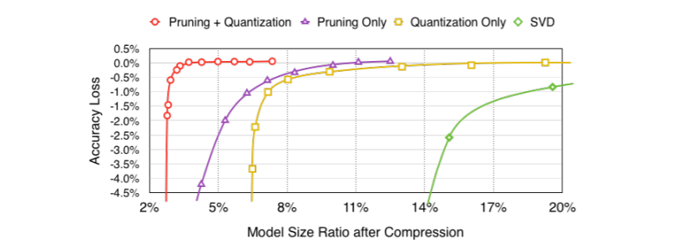
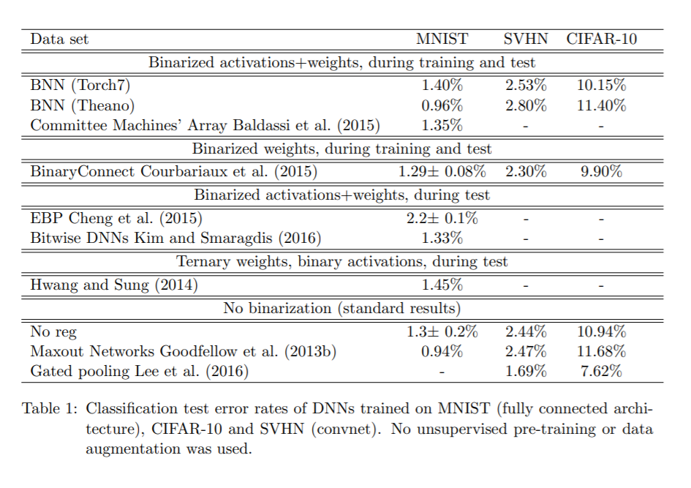
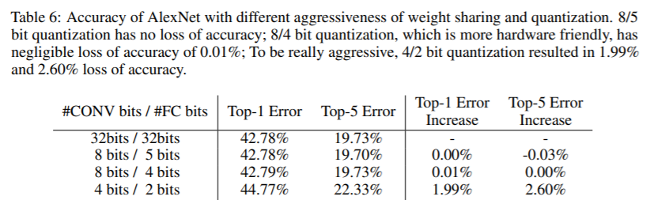
Effect of Methods

Slide 15
Discussion
How much can be achieved via quantization alone
Are the methods described enough to be reproduced?
Focus is on energy and size. Given what we saw in previous papers should we expect that leads to faster execution time?

